Slide 1
Machine Learning with Scikit-learn part 2

Slide 2
How good is your model?
Classification metrics
Measuring model performance with accuracy:
Fraction of correctly classified samples
Not always a useful metric

Slide 3
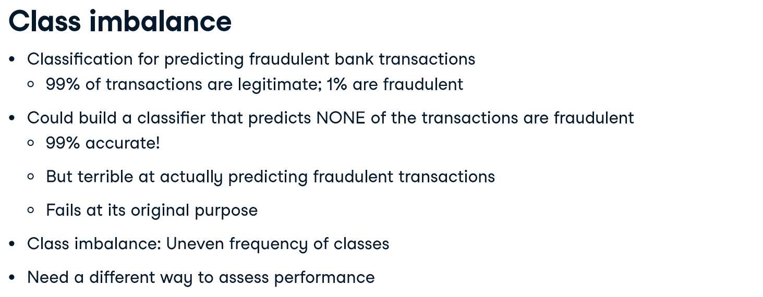
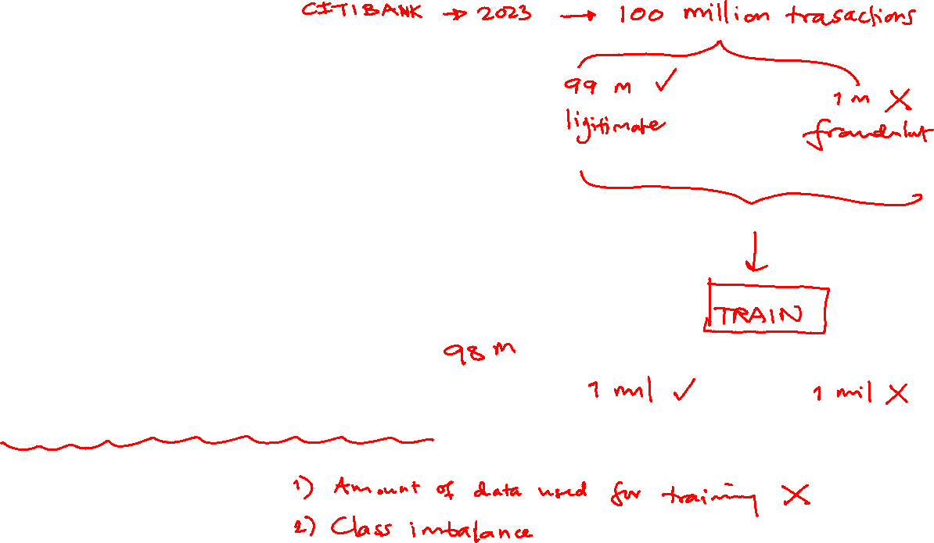

Slide 4
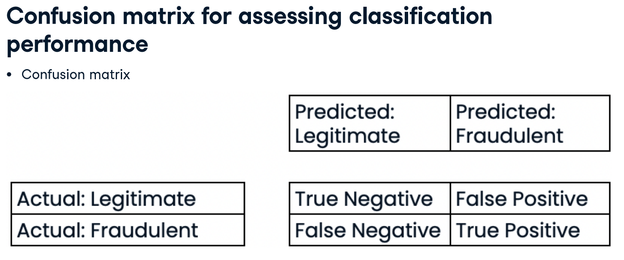
The false negatives are the number of fraudulent transactions incorrectly labeled
The false positives are the number of legitimate transactions incorrectly labeled as fraudulent.
The true negatives are the number of legitimate transactions correctly labeled
The true positives are the number of fraudulent transactions correctly labeled

Slide 5
Example: Image recognition, indicating image is dog or not
Index | 1 | 2 | 3 | 4 | 5 | 6 | 7
Actual | Dog | Dog | Dog | Not Dog | Dog | Not Dog | Dog
Predicted | Dog | Not Dog | Dog | Not Dog | Dog | Dog | Dog
Result | TP | FN | TP | TN | TP | FP | TP
TRUE | T | F | T | T | T | F | T
Positive/Negative | P | N | P | N | P | P | P
True/False <= Prediction is matched Actual
Positive/Negative <= Prediction result is dog ?

Slide 6
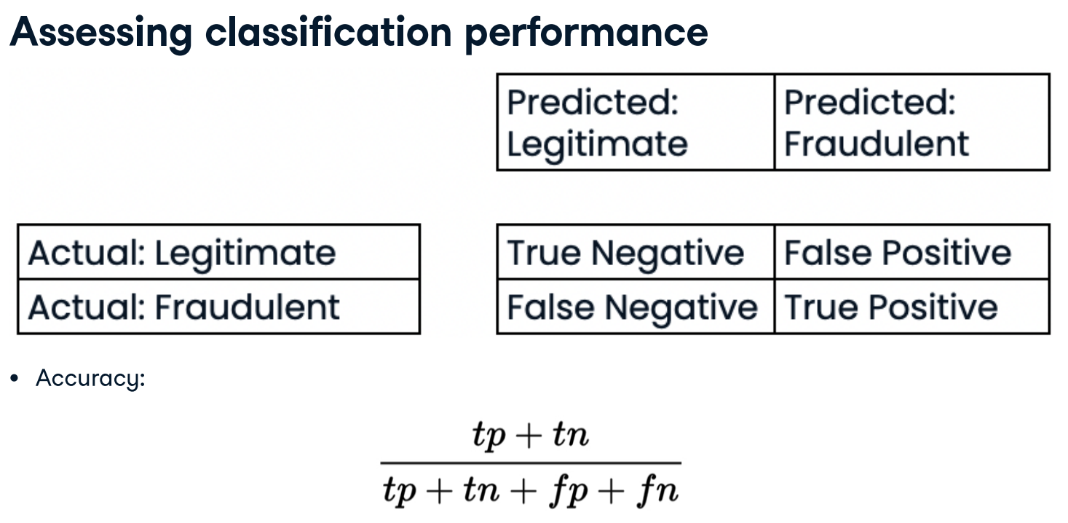
Firstly, we can retrieve accuracy: it's the sum of true predictions divided by the total sum of the matrix.

Slide 7
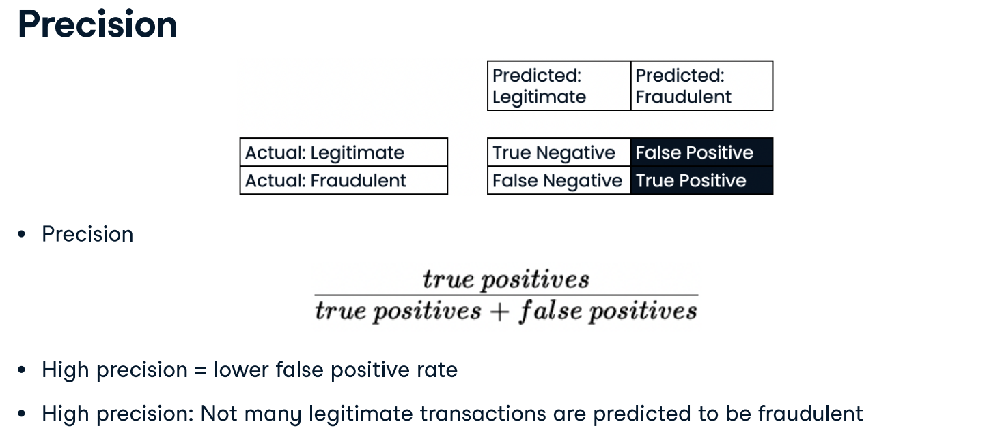
Usually, the class of interest is called the positive class. As we aim to detect fraud, the positive class is an illegitimate transaction. So why is the confusion matrix important? There are other important metrics we can calculate from the confusion matrix. Precision is the number of true positives divided by the sum of all positive predictions. It is also called the positive predictive value. In our case, this is the number of correctly labeled fraudulent transactions divided by the total number of transactions classified as fraudulent. High precision means having a lower false positive rate.

Slide 8
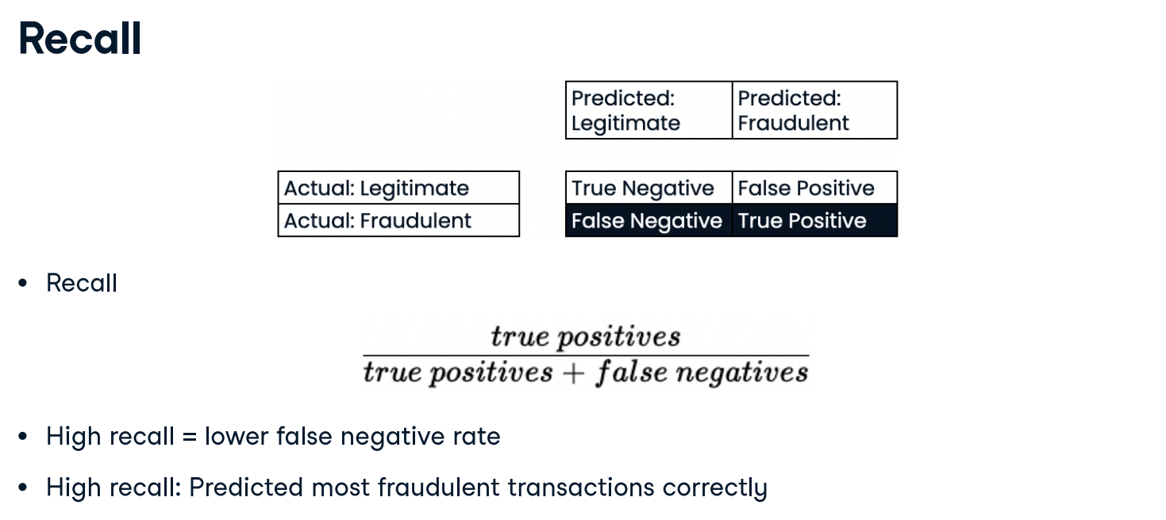
Recall is the number of true positives divided by the sum of true positives and false negatives. This is also called sensitivity. High recall reflects a lower false negative rate. For our classifier, it means predicting most fraudulent transactions correctly.

Slide 9
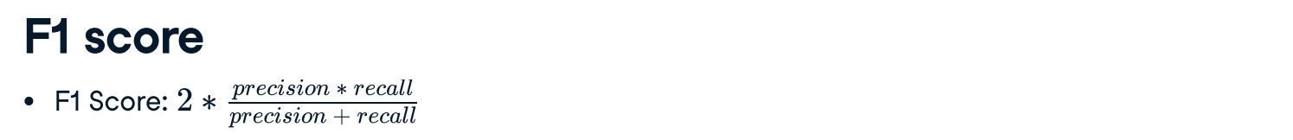
The F1-score is the harmonic mean of precision and recall. This metric gives equal weight to precision and recall, therefore it factors in both the number of errors made by the model and the type of errors. The F1 score favors models with similar precision and recall, and is a useful metric if we are seeking a model which performs reasonably well across both metrics.

Slide 10
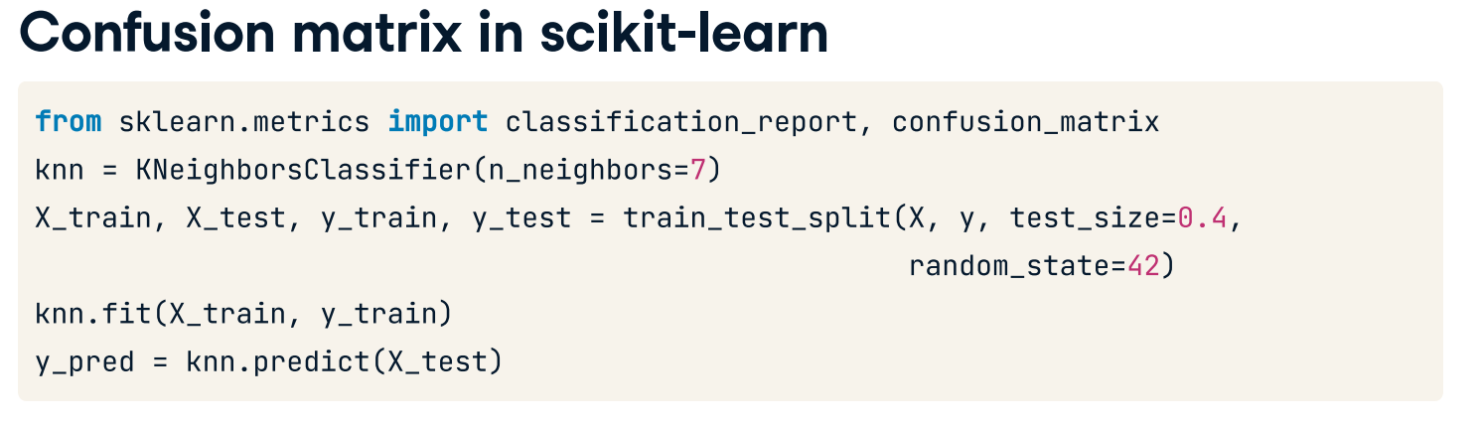
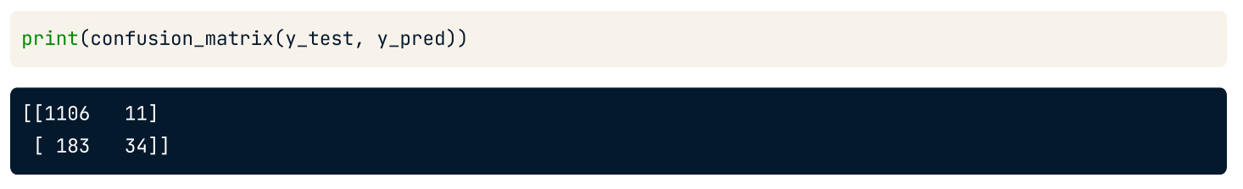
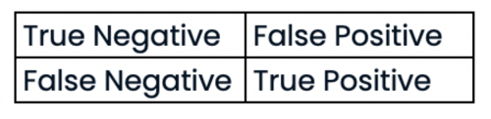

Slide 11
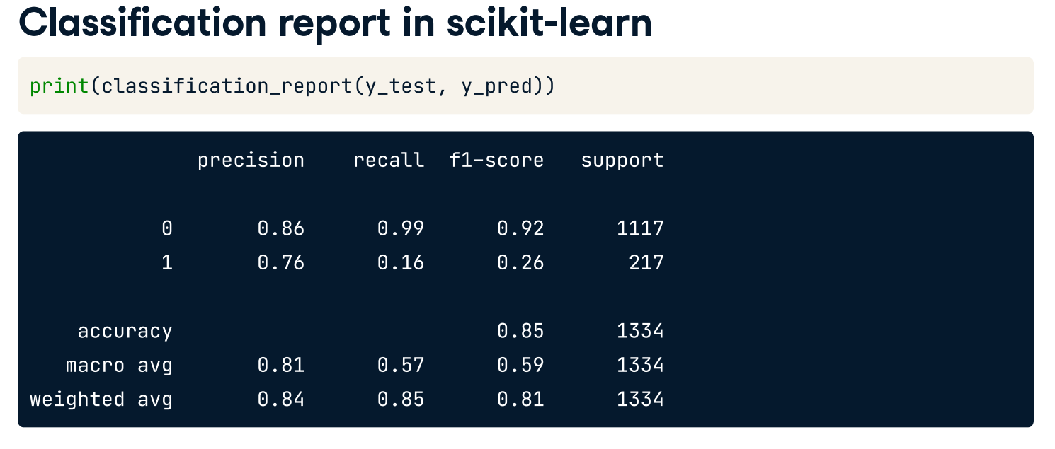
This report includes precision and recall by class (churn: 1 or no churn: 0), point-seven-six and point-one-six for the churn class respectively, which highlights how poorly the model's recall is on the churn class. Support represents the number of instances for each class within the true labels. (Class imbalance)

Slide 12
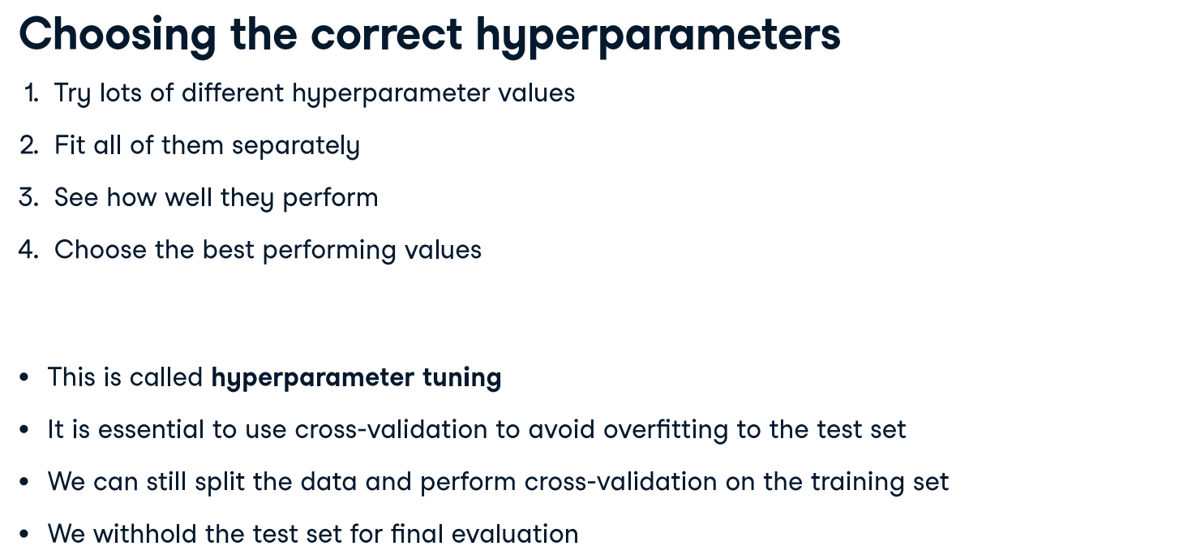
Hyperparameter tuning
KNN: choosing n_neighbors
Hyperparameters: parameters we specify before fitting the model

Slide 13
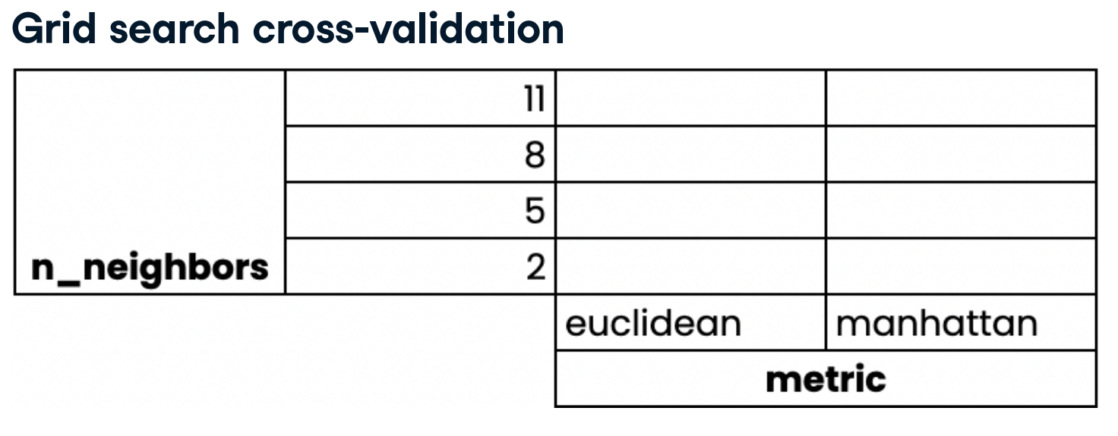
We perform k-fold cross-validation for each combination of hyperparameters. The mean scores for each combination are shown here. By default, KNN uses Euclidean distance but Manhattan distance can be selected by setting p = 1.
For example, .KNeighborsClassifier(n_neighbors=5, p=1)

Slide 14
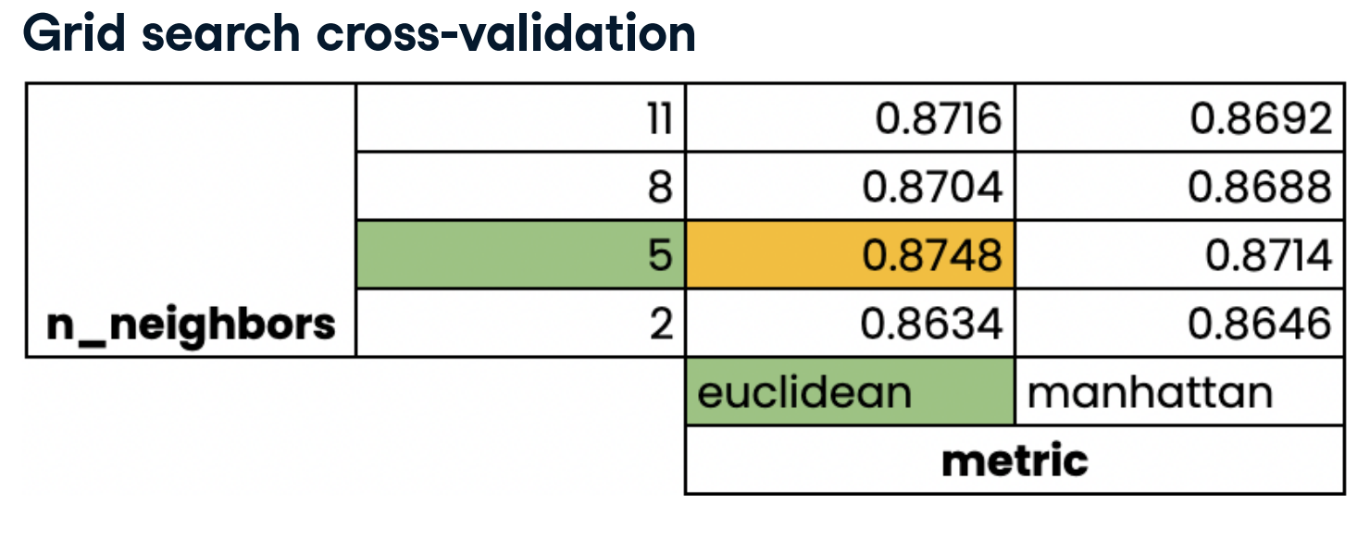

Slide 15
Preprocessing Data

Slide 16
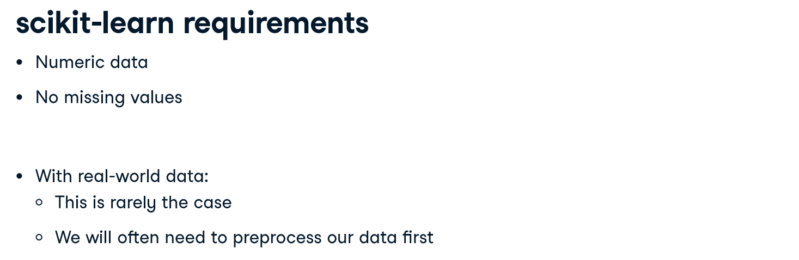
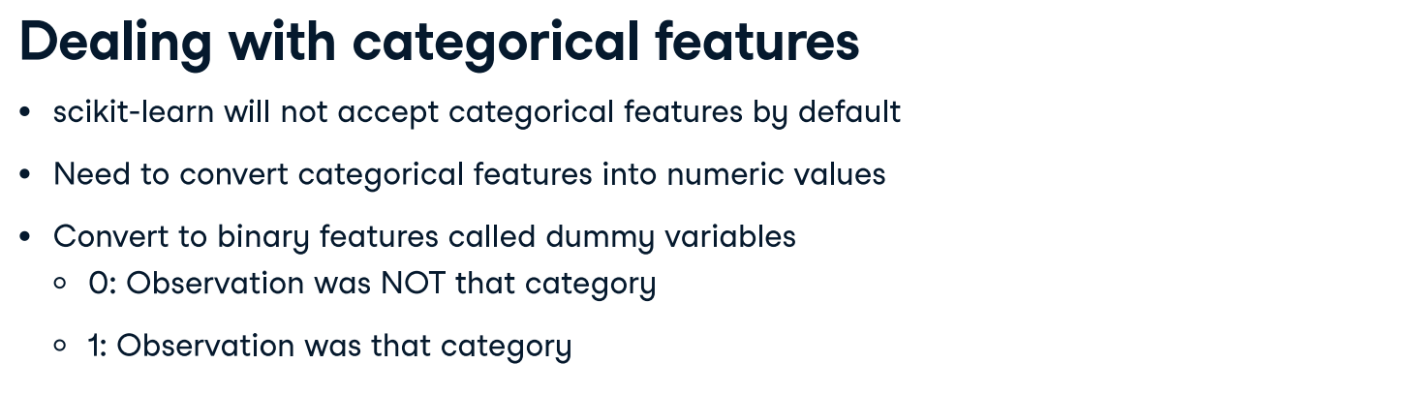

Slide 17
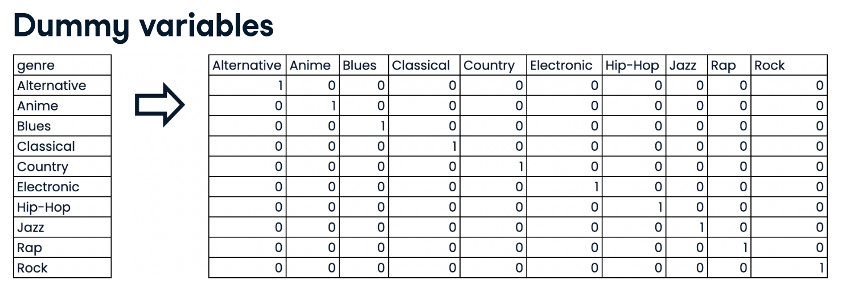

Slide 18
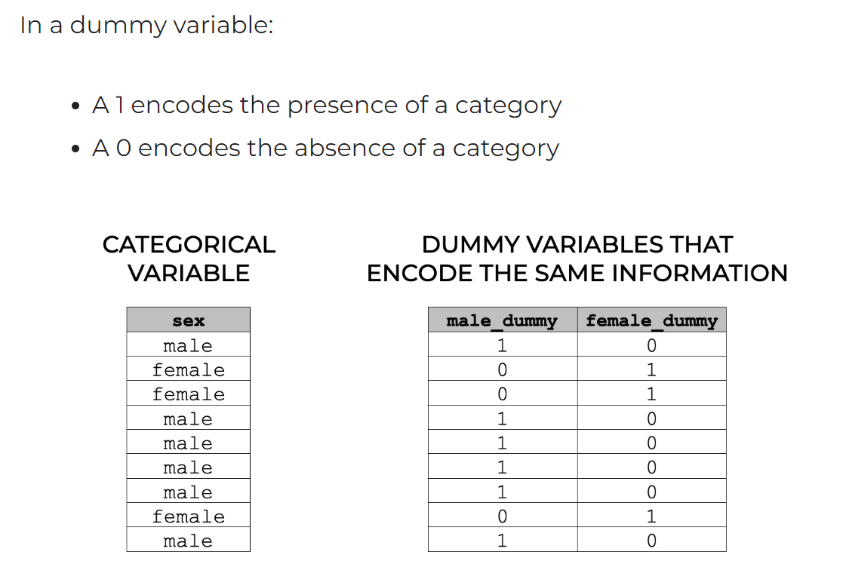

Slide 19
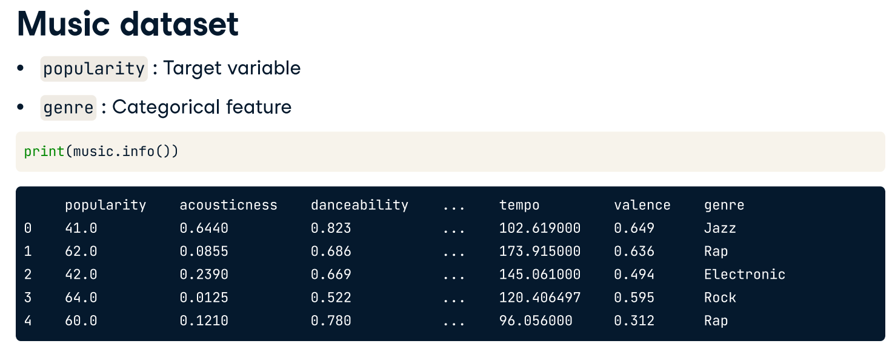
We will be working with a music dataset in this chapter, for both classification and regression problems. Initially, we will build a regression model using all features in the dataset to predict song popularity. There is one categorical feature, genre, with ten possible values.

Slide 20
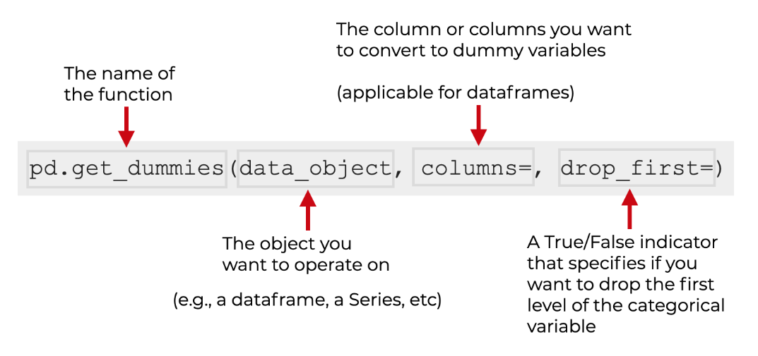
The drop_first parameter specifies whether or not you want to drop the first category of the categorical variable you’re encoding.
By default, this is set to drop_first = False. This will cause get_dummies to create one dummy variable for every level of the input categorical variable.
If you set drop_first = True, then it will drop the first category. So if you have K categories, it will only produce K – 1 dummy variables.

Slide 21
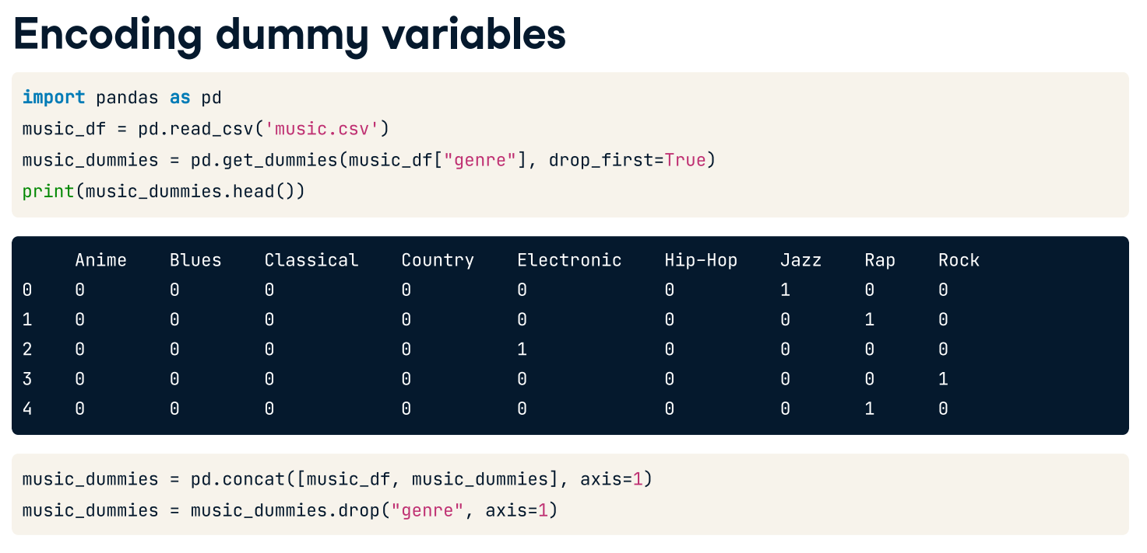

Slide 22
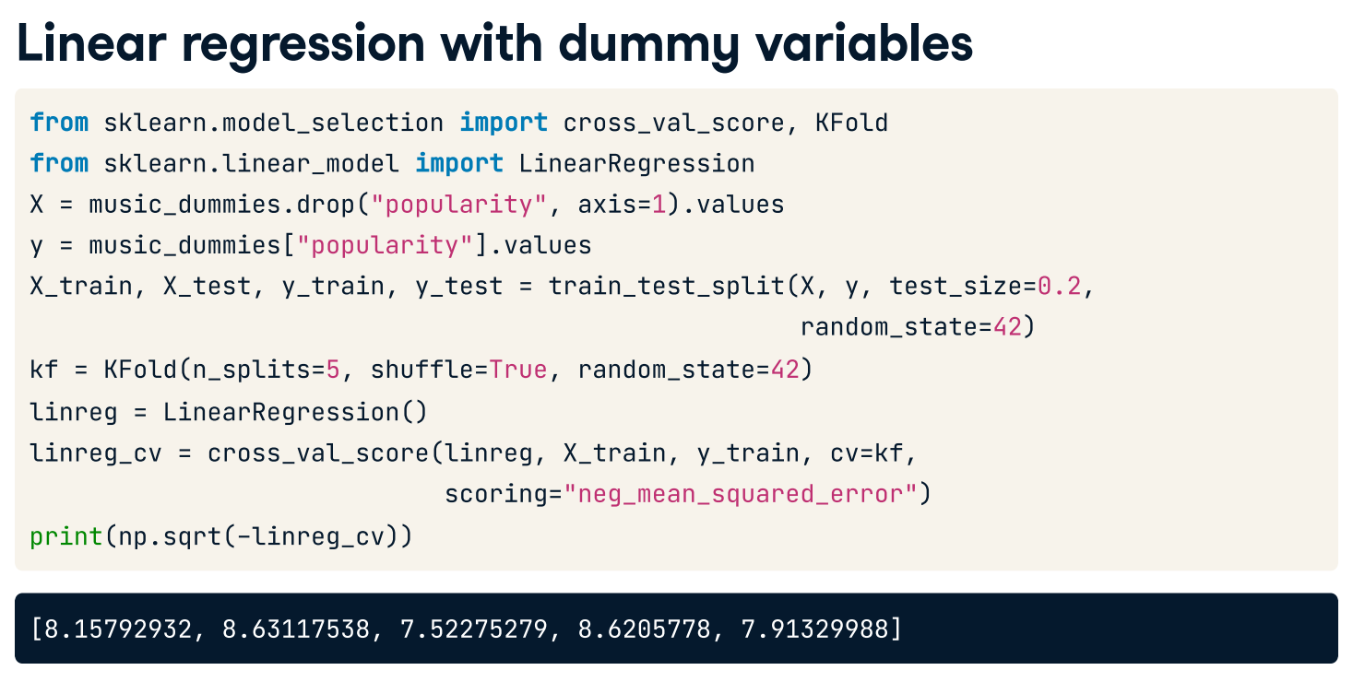

Slide 23
music_df = pd.read_csv('music.csv', index_col = 0)
music_dummies = pd.get_dummies(music_df['genre'], drop_first=True)
#music_dummies.head()
music_dummies = pd.concat([music_df, music_dummies], axis = 1)
music_dummies = music_dummies.drop('genre', axis=1)
#music_dummies.head()
print(music_dummies.columns)
#from sklearn.model_selection import cross_val_score, KFold
#from sklearn.linear_model import LinearRegression
X = music_dummies.drop('popularity', axis=1).values
y = music_dummies['popularity'].values
X_train, X_test, y_train, y_test = train_test_split(X,y, test_size=0.2,
random_state=42)
kf = KFold(n_splits=5, shuffle=True, random_state=42)
linreg = LinearRegression()
linreg_cv = cross_val_score(linreg, X_train, y_train, cv=kf,
scoring='neg_mean_squared_error')
print(np.sqrt(-linreg_cv))
Codes for slide 20-22

Slide 24
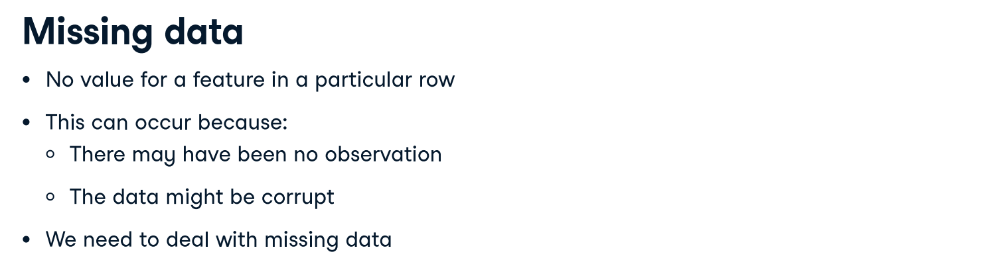
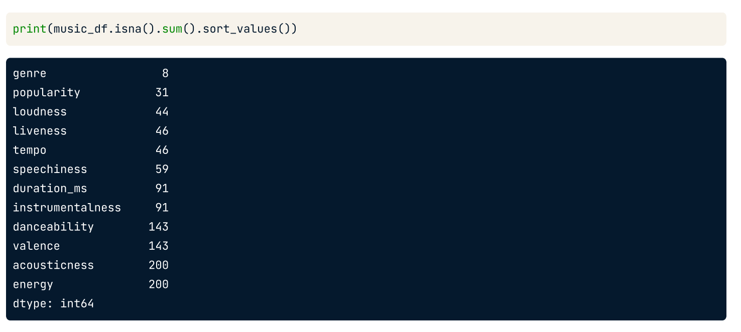
music_df = pd.read_csv('music_unclean.csv', index_col = 0)

Slide 25
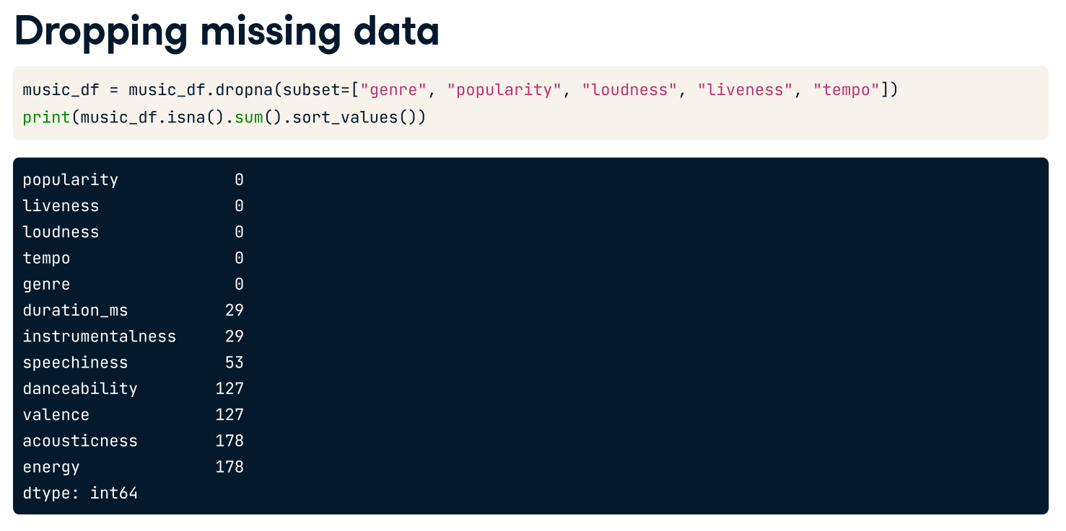

Slide 26
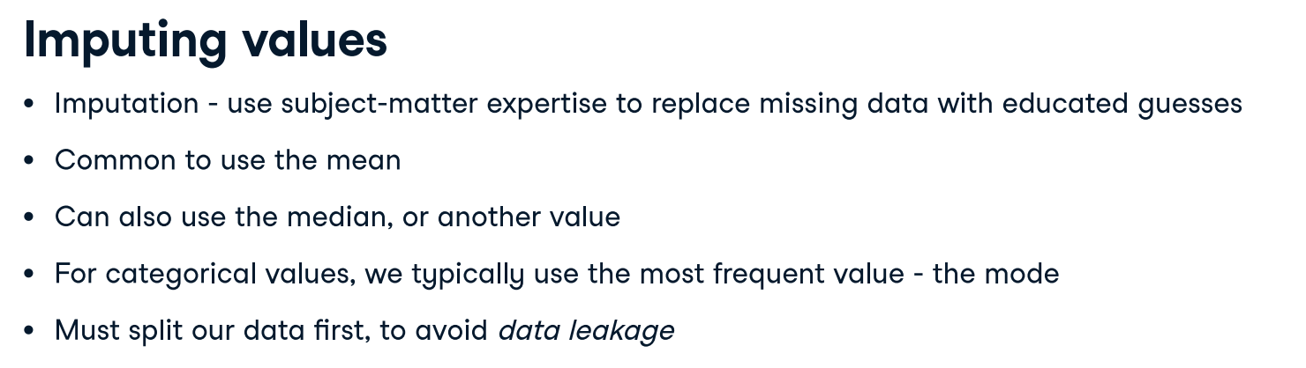

Slide 27
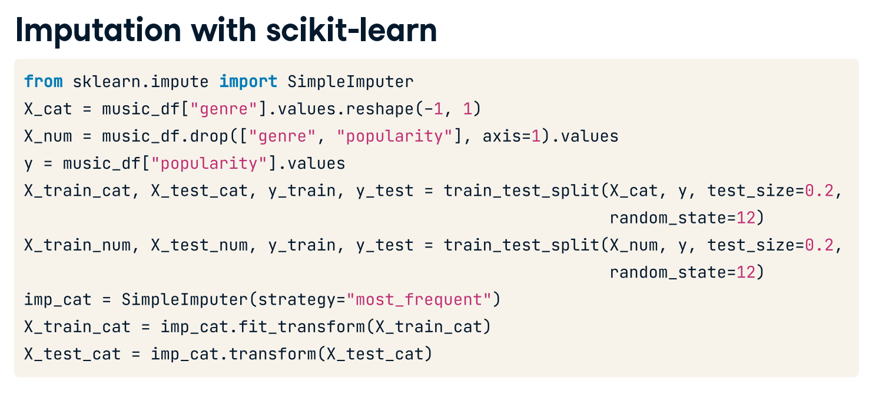
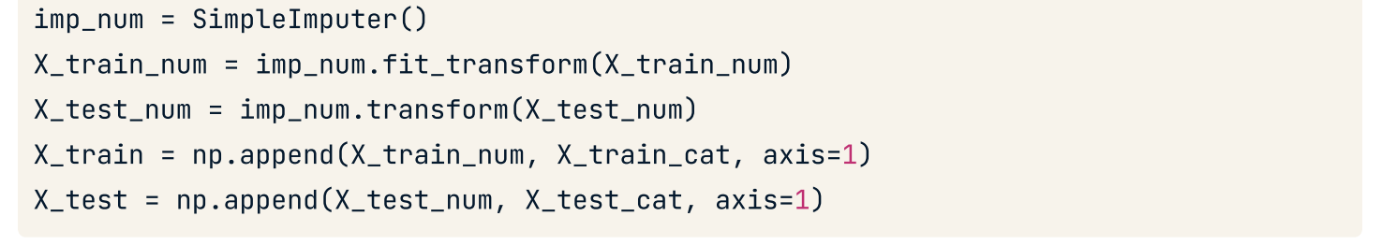
knn = KNeighborsClassifier(n_neighbors=5)
knn.fit(X_train, y_train)
y_pred = knn.predict(X_test)
print(knn.score(X_test, y_test))

Slide 28
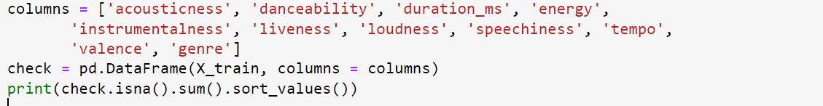

Slide 29
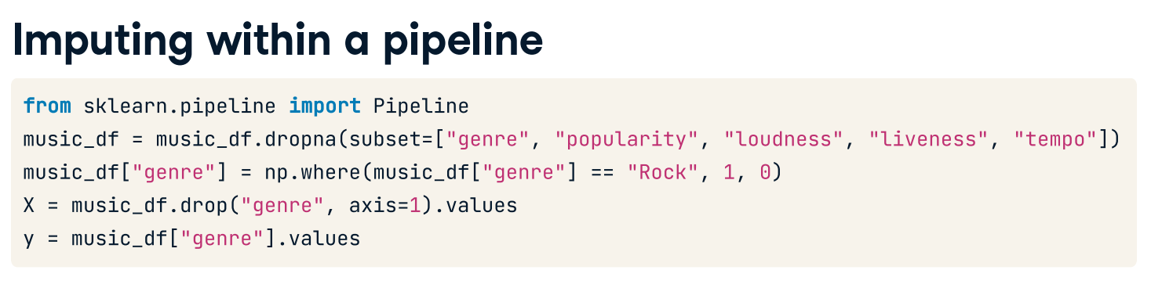
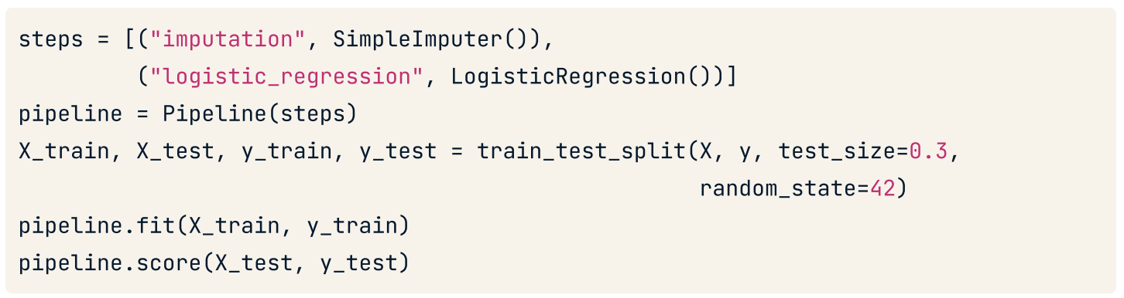

Slide 30
from sklearn.pipeline import Pipeline
from sklearn.linear_model import LogisticRegression
music_df = pd.read_csv('music_unclean.csv', index_col = 0)
music_df = music_df.dropna(subset=['genre','popularity','loudness','liveness','tempo'])
music_df['genre'] = np.where(music_df['genre'] == 'Rock', 1, 0)
X = music_df.drop('genre', axis = 1).values
y = music_df['genre'].values
X_train, X_test, y_train, y_test = train_test_split(X,y,test_size=0.3,random_state=42)
#imp = SimpleImputer()
#logres = LogisticRegression()
#steps = [('imputation’, imp),
('Log_reg’, logres)]
steps = [('imputation', SimpleImputer()),
('Log_reg', LogisticRegression(max_iter = 100000))]
pipeline = Pipeline(steps)
pipeline.fit(X_train, y_train)
y_pred = pipeline.predict(X_test)
print(confusion_matrix(y_test, y_pred))
print(pipeline.score(X_test,y_test))

Slide 31
Handling Missing Data, Imputing Data and Pipelining
You are going to tidy the music_df dataset. You will create a pipeline to impute missing values and build a KNN classifier model, then use it to predict whether a song is of the "Rock" genre.
In this exercise specifically, you will drop missing values accounting for less than 5% of the dataset, and convert the "genre" column into a binary feature.
Instructions:
Load the music_df from music_unclean.csv and print the number of missing values for each column in the music_df dataset, sorted in ascending order.
Remove values for all columns with 50 or fewer missing values.
Convert music_df["genre"] to values of 1 if the row contains "Rock", otherwise change the value to 0.
X = all columns except genre
y = genre
Split data with test_size = 30 and random state set to 42
Instantiate an imputer.
Instantiate a KNN classifier with three neighbors.
Create steps, a list of tuples containing the imputer variable you created, called "imputer", followed by the knn model you created, called "knn".
Create a pipeline using the steps you previously defined.
Fit the pipeline to the training data.
Make predictions on the test set.
Calculate and print the confusion matrix.

Slide 32
music_df = pd.read_csv('music_unclean.csv', index_col = 0)
#print(music_df.isna().sum().sort_values())
music_df = music_df.dropna(subset=["genre", "popularity", "loudness", "liveness", "tempo"])
print(music_df.isna().sum().sort_values())
print("Shape of the `music_df`: {}".format(music_df.shape))
# Convert genre to a binary feature
music_df["genre"] = np.where(music_df["genre"] == "Rock", 1, 0)
X = music_df.drop('genre', axis = 1).values
y = music_df['genre'].values
X_train, X_test, y_train, y_test = train_test_split(X,y,test_size=0.3,random_state=42)
# Instantiate an imputer
imputer = SimpleImputer()
X_train = imputer.fit_transform(X_train) ###################
X_test = imputer.transform(X_test) ###################
# Instantiate a knn model
knn = KNeighborsClassifier(n_neighbors=3)
# Build steps for the pipeline
steps = [("imputer", imputer),
("knn", knn)]
# Create the pipeline
pipeline = Pipeline(steps)
# Fit the pipeline to the training data
pipeline.fit(X_train, y_train)
# Make predictions on the test set
y_pred = pipeline.predict(X_test)
# Print the confusion matrix
print(confusion_matrix(y_test, y_pred))
print(pipeline.score(X_test,y_test))
#print(X_train.shape)
columns = ['acousticness', 'danceability', 'duration_ms', 'energy',
'instrumentalness', 'liveness', 'loudness', 'speechiness', 'tempo',
'valence', 'genre']
check = pd.DataFrame(X_train, columns = columns)
print(check.isna().sum().sort_values())

Slide 33
Repeat the previous task without using the pipeline. Also, find the best K with test_size set to 0.2 and 0.3.

